Slide 1
Data Analysis: Sales Prospects from Home Mortgage Data

Slide 2
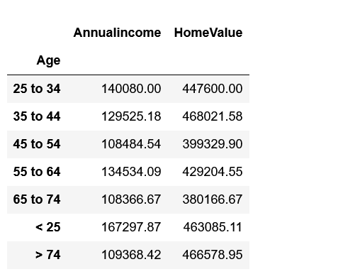
Observation or data here…

Slide 3
Observations and Key Insights
A
B
C
D

